Slide 1
Continuous not grid world
agent = MazeAgent(dt=0.05, v=0.1, numRooms=1, roomSize=1, policy='randomWalk')
agent.walls['barrier'] = np.array([[[0.3,0.7],[0.7,0.3]]])
for i in tqdm(range(2000)):
agent.movementPolicyUpdate()
fig, ax = agent.plotHistory()
Position is a continuous variable:
Walls are true 1D objects
A check is done on each step to handle wall collisions
A function maps continuous position to a (quantized?) state-rep, e.g. one-hot

Slide 2
Generalised SR-TD
Use general SR form. M is a matrix which maps some state vector onto another vector which I the discounted summer future occupancy
I.e. Ψ(S) is:
So we can learn Ψ(S) by standard TD methods
Or as a direct learning rule on M, this is can be rewritten as (assuming rescaling of α or normalised state vectors)
All that remains is to show that with one-hot numbered states, f(S_{t})_{i} = δ(i = S_{t}), standard SR equation comes out.
Shouldn’t matter if f is not normalised as this is absorbed into alpha
e.g. de Cothi 2020, it’s what I’m implementing
matrix columns give future occupancy i.e. place fields
e.g. Stachenfeld 2017

Slide 3
Place cells and grid cells
agent.alpha = 0.2
agent.gamma = 0.99
agent.dx = 0.1
for i in tqdm(range(100000)):
agent.movementPolicyUpdate()
agent.TDLearningStep()
fig, ax = agent.plotPlaceField()
fig, ax = agent.plotGridField()
γ = 0.9
γ = 0.999
Place cells leak over barrier since positions on either side of the barrier can map to same state rep

Slide 4
Two rooms
agent.doorsClosed = True
agent.doorsClosed = False
Biggest problems:
• Can be slow to train
• Defining position to state rep function non-trivial (I guess that’s the whole point)

Slide 5
Four rooms
Biggest problems:
• Can be slow to train
• Defining position to state rep function non-trivial (I guess that’s the whole point)

Slide 6
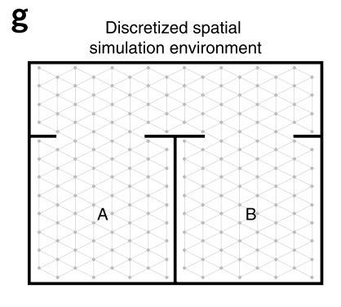
Grid cells bleeding across boundaries
Vertical / horizontal boundaries only ☹
Biggest problems:
• Can be slow to train
• Defining position to state rep function non-trivial (I guess that’s the whole point)

Slide 7
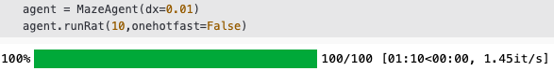
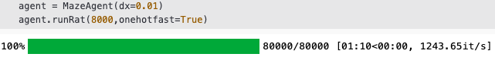
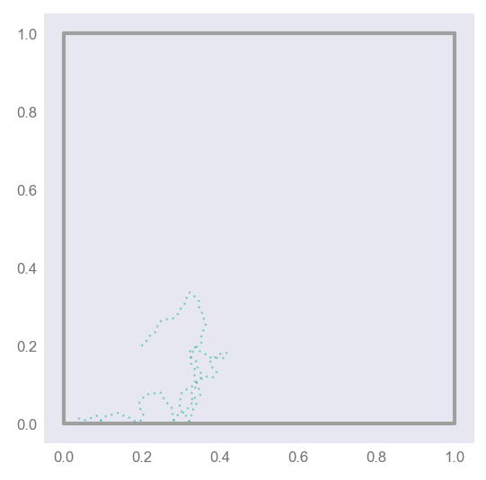
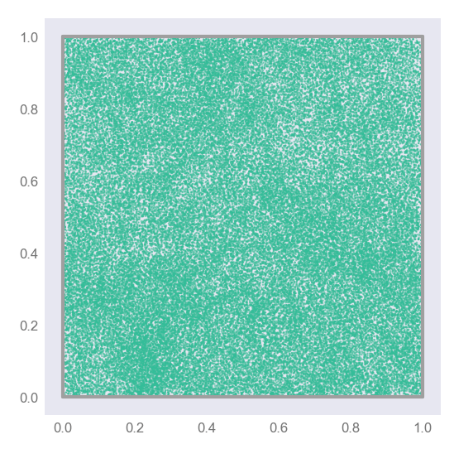
Code speed-up, O(1000x)
General formula:
One-hot specific formula:
Biggest problems:
• Can be slow to train
• Defining position to state rep function non-trivial (I guess that’s the whole point)

Slide 8
Motion models
Random Walk
Raudies
Windows screensaver

Slide 9
New mazes
Explore
Place
Grid

Slide 10
Continuous time and state TD learning:
Discrete state (one-hot)
Discrete time
Continuous state (e.g. BVCs)
Discrete time
Continuous state
Continuous time
e.g. Doya, 1996
Decouples γ from dt, i.e. decouples learning from the motion model

Slide 11
Proof:
normalised
Logical continuous-time
analogue
True if our estimate of Ψ, is correct
If it isn’t, we should update it (TD learning)
Re-discretising we get:
#time-step independent TD update
delta = prevState + (self.tau / dt) * (self.M @ ((1 - dt/self.tau)*state - prevState))
self.M = self.M + alpha * np.outer(delta, prevState)

Slide 12
Independence on dt
dt = 0.01
dt = 0.1
dt = 0.2
Dependence on τ
Tau = 1s
Tau = 2s
Tau = 4s

Slide 13
Neurobiological SR (gaussian receptive fields)
Resolution
independent

Slide 14
Neurobiological SR (centre-surround receptive fields)
Resolution
independent

Slide 15
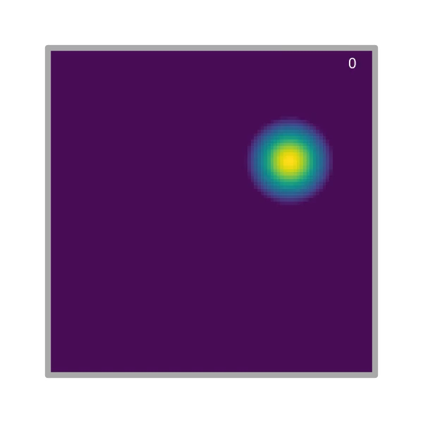
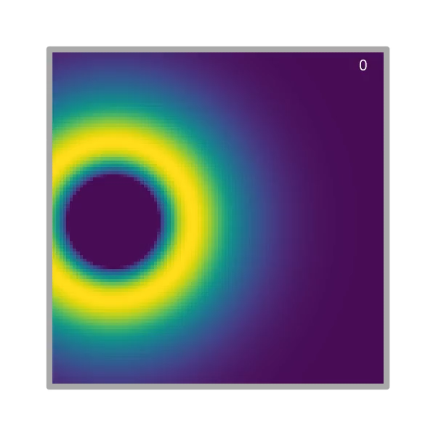
Place
Grids

Slide 16
Neurobiological SR (fourier modes)
Resolution
independent

Slide 17
Place
Grids

Slide 18
Place fields
Grid fields

Slide 19
Interpretation of place fields

